Slide 1
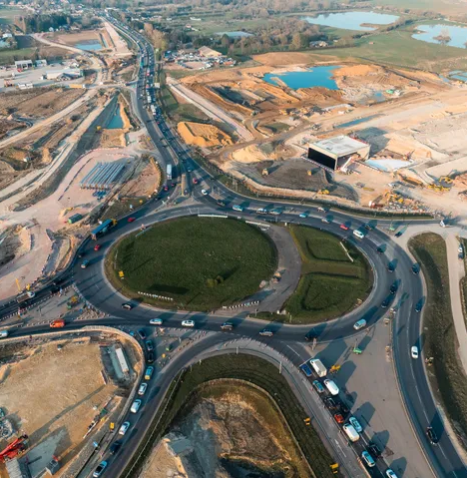
Working with neurodivergent colleagues
Jennifer Tomlinson & Jack Daly
University of Leeds

Slide 2

Overview
In the U.K., it’s estimated that between 15-20% of people are neurodivergent.
It’s estimated that 70-80% of disabilities are non-visible, including neurodiversity.
Statistics in the workplace are difficult due to voluntary disclosure, but at least 25% of construction workers consider themselves to have a neurodiverse condition.

Slide 3
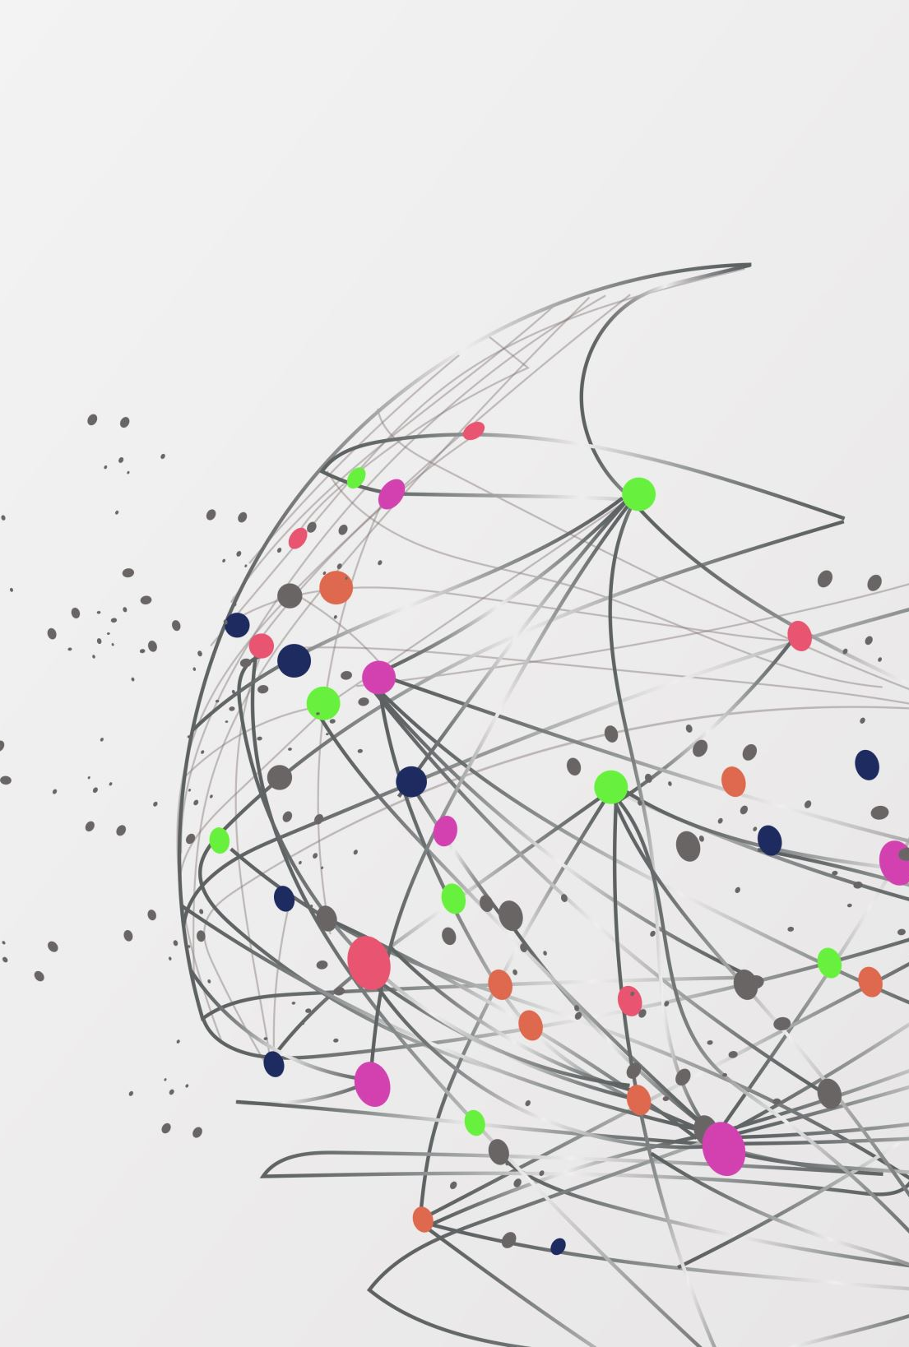
Definitions of Neurodiversity and Neurodivergence

Slide 4
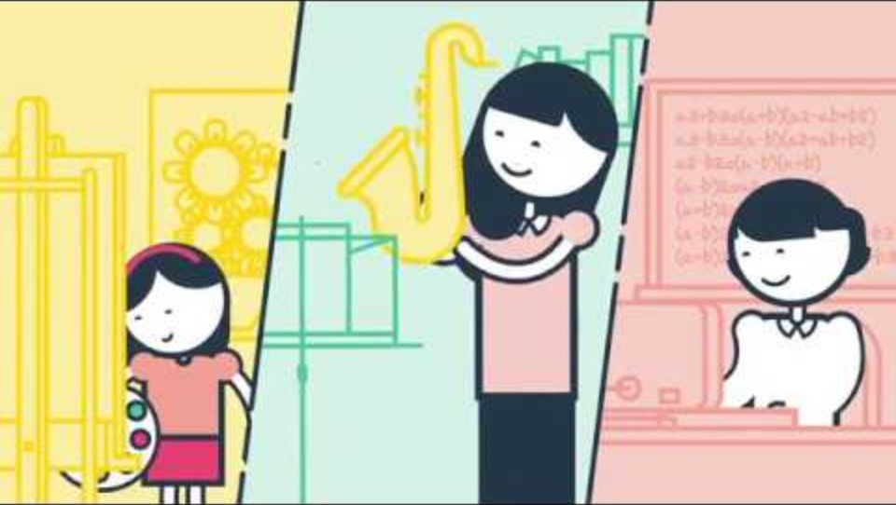
What is neurodiversity?

Slide 5
Definition of Neurodiversity
Neurodiversity is the diversity of human minds, the vast variation in neurocognitive functioning.
Neurodiversity is not a trait that any individual possesses or can possess. When an individual or group of individuals diverges from the dominant societal standards of “normal” neurocognitive functioning, they don’t “have neurodiversity,” they are neurodivergent.
Dr Nick Walker (2014), https://neuroqueer.com/neurodiversity-terms-and-definitions/

Slide 6

Neurodivergence and neurominorities
Autism
Dyslexia
ADHD
Dyspraxia
Dyscalculia
Tourette Syndrome
…and more?

Slide 7
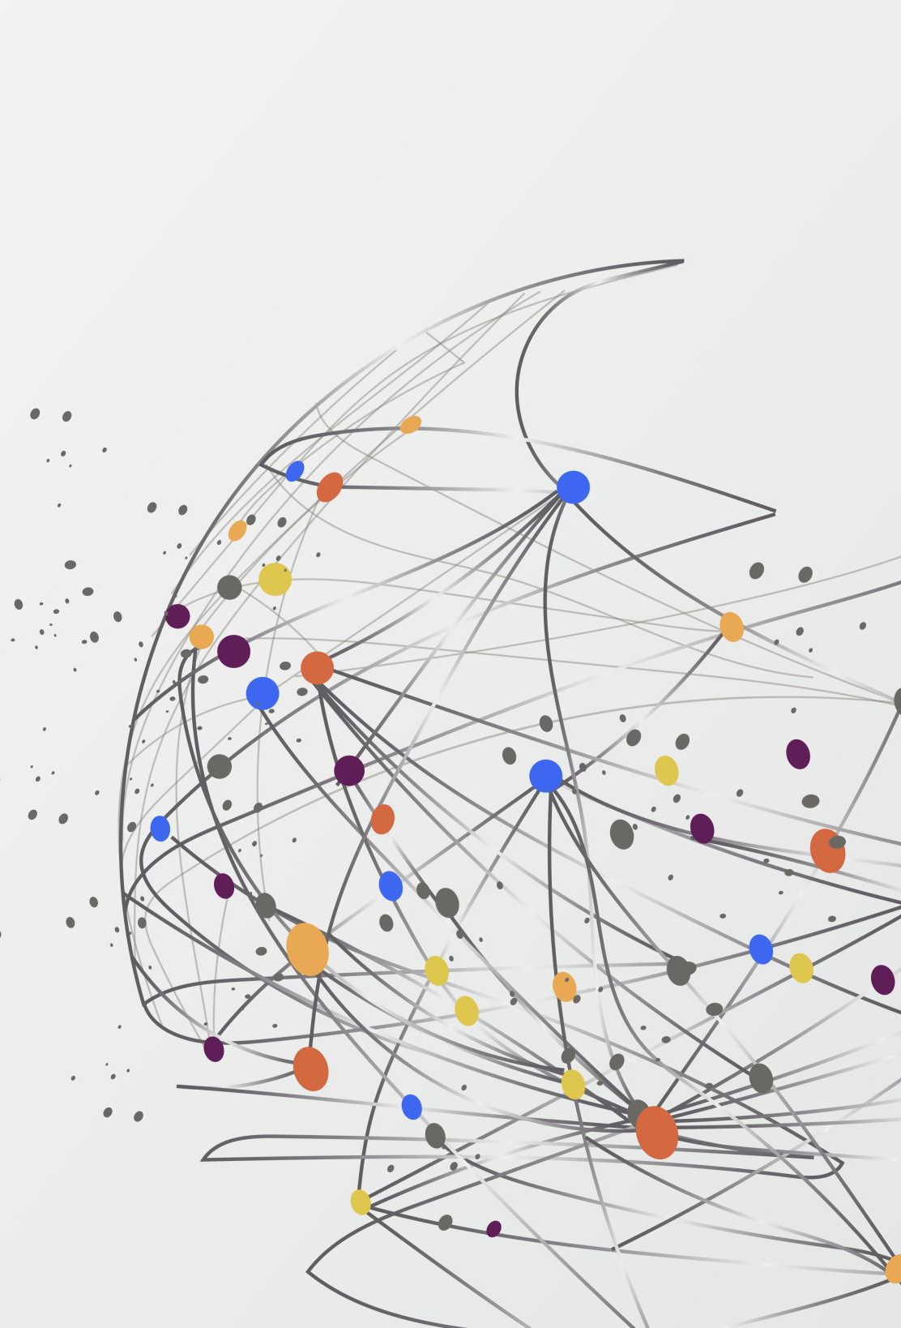
Neurodivergence: commonality of difference

Slide 8
Executive function and work-based skills
Valued skills for work:
Organisation
Time management
Communication
Collaboration
Focus
Social interactions
Multitasking
Impact of neurodivergence:
Difficulty organising self
Different concept of time
Different communication
Anxiety about collaboration
Different focus
Different social interactions
Difficulty switching task

Slide 9
How we process information: the neurotypical approach
Information
Filtering
Intuition
Decision

Slide 10
How we process information: a neurodivergent approach
Anxiety
Information
Overload
Decision
Processing
?
More information
Analysis
Categorisation
Anxiety
Overload

Slide 11
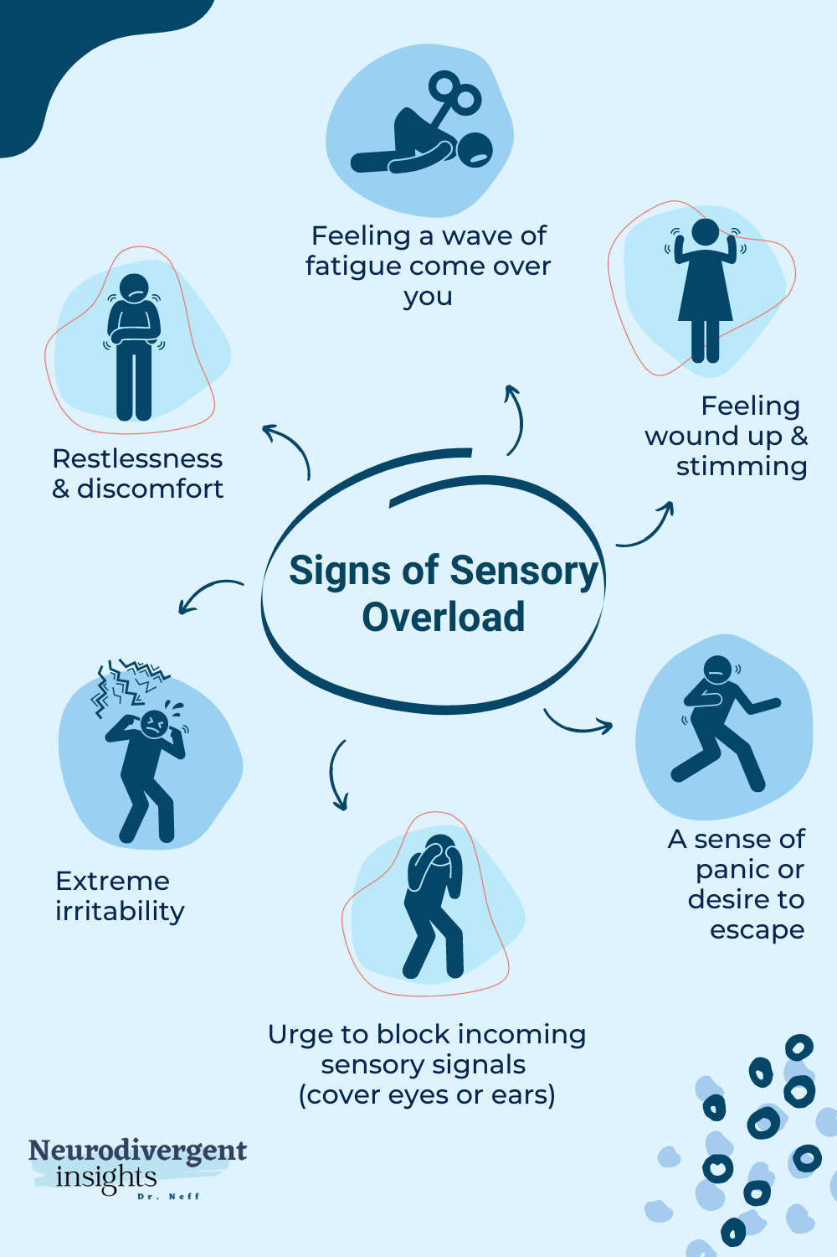
Sensory processing
We have more than 5 senses!
Sensory hyper- or hypo-sensitivity (experiencing too much or too little)
Hypersensitivity = overload and can be physically painful
Causes ‘interference’ = distraction
Hyposensitivity can lead to well-being issues

Slide 12
Masking or ‘projecting acceptability’
Imitating facial expressions
Bottling up anxiety
Suppressing stims
Trying to fit in
Hiding emotions
Trying to focus
Acting ‘normal’
Forcing eye contact
Exhaustion
Burnout
Loss of identity
Misdiagnosis

Slide 13
Supporting neurodiverse colleagues

Slide 14
Strategies to support neurodiverse colleagues
Get to know the person – talk and listen!
Under promise and over-deliver
Adjust your communication
Check the sensory environment
Be clear, concise and unambiguous
Give details – who, what, where, when, how
Don’t force eye contact – sit side by side
Anticipate and prepare
Set explicit expectations
Use ‘what if’ planning

Slide 15
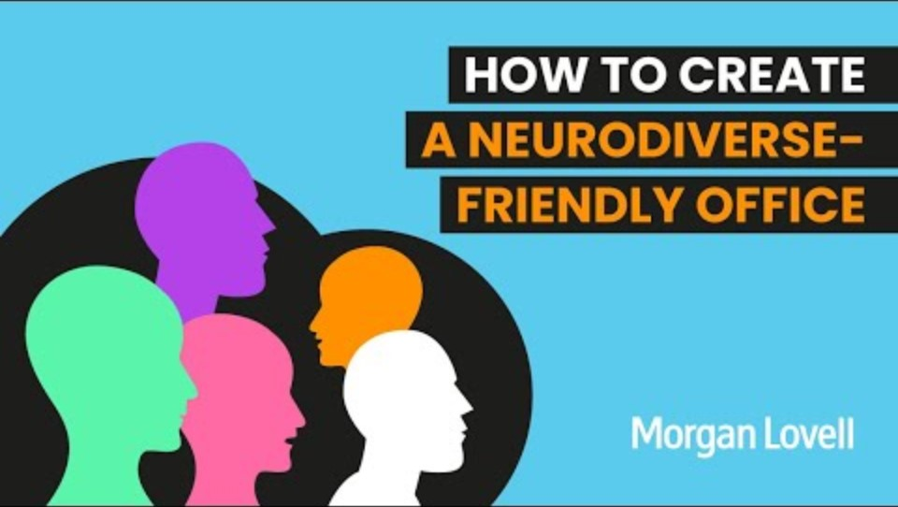
Creating neurodiverse-friendly workplaces

Slide 16
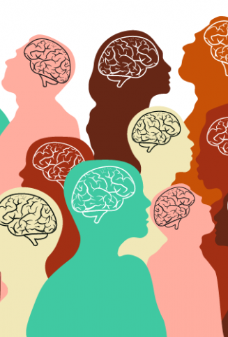
Lived experiences of neurodiversity and work
This Photo by Unknown Author is licensed under CC BY-SA-NC

Slide 17

Questions & Discussion

